Slide 1
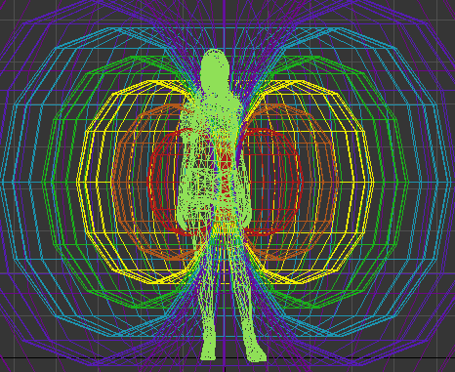
Aura OZ
Super Intelligent Operating Zeitgeist
Real-Time Location Based Social Networks
Harness Multiple Realities & The Internet of Things
*MVP: Simple 7 Torus VR Aura with ability to fit content to each facet

Slide 2
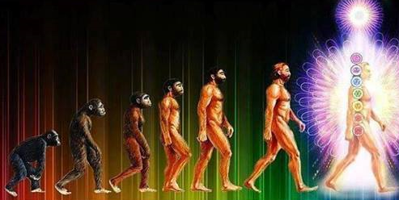
The Core Problem To Be Solved By AuraOZ
“Not Knowing Oneself”
Individual Problems: Societal Keystones:
Mental degenerative diseases How society knows itself
Mid life crisis's and depression How society values itself
Guidance on parenting children Participatory Governance
Curating ideal dating & marriage Joyful Responsible Abundance
Becoming an accomplished adult General Super Intelligence

Slide 3
Degenerative Problems: Dementia, Alzheimer's & Aging
Mental problem Set
“With continued development of the AuraOZ concept, people could build & wear a digital self and VR Aura Interface between them and the internet of things to supplement their life and extend their abilities.”
“A digital self in an Aura could serve simple things such as reminders and home automation or manage complicated schedules, customized lesson plans, wellbeing, mobility aid and much more.” Luke Hayes
Loss of Short Term Memory
Loss of Cognitive Ability
Loss of Long Term Memory
Physical problem Set
Unable to navigate confidently
Unable to perform menial tasks
Unable to perform complex tasks
Unhappy with level of independence

Slide 4
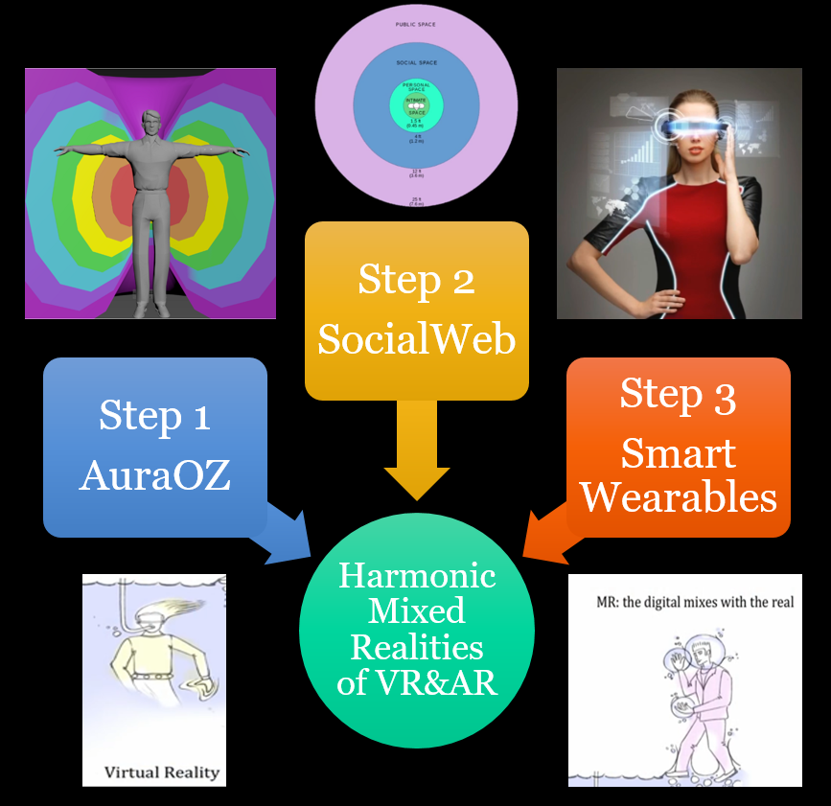
“Our Solution”
A virtual reality Aura with a seed & instructions to personally build a unique super intelligent light field.
Visual, audible & body language patterns synchronized to begin & tune social experiences in real locations, virtual realities & even multiple realities all at once.
Next generation smart wearables that are custom designed for each body, mind, soul personality to easily & fluently co-create & thrive in our reality plus infinite dream worlds.

Slide 5
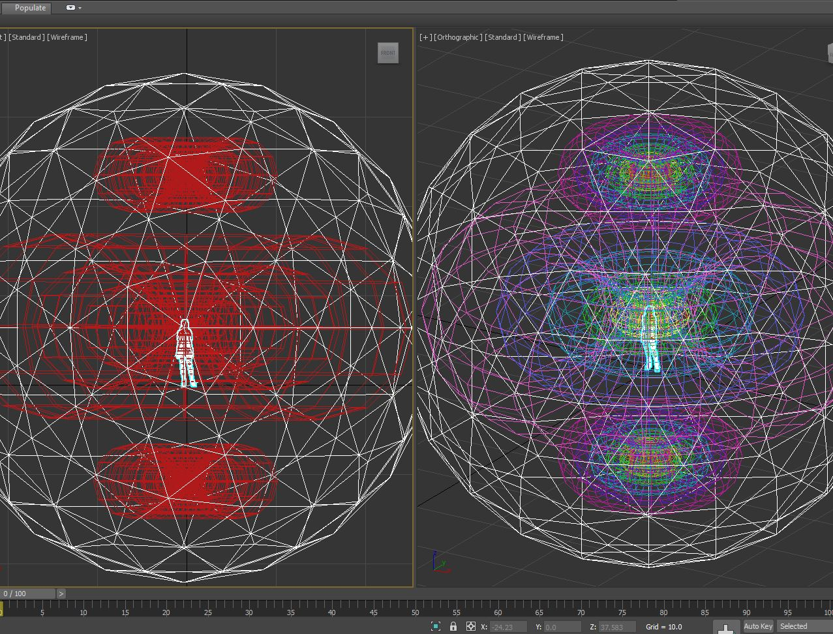

Slide 6
Unique Selling Proposition and Future Direction
An ⁿD XR + AGI Operating System for Life, Games & Evolving in Joy
Intelligent Geometric Light Fields
Interoperable With All Languages
An avatar relative to the operators body
Adjustable values & interest hierarchies
Customizable interactive visualizations
Verifiable reputations & dating profiles
Millionaire AuraOZ for top role models
Geometric, colored, hieroglyphic language
Values & virtues of all cultures translated
Participatory global governance protocols
Customizable travel modes for worldwide
Billionaire AuraOZ for special role models

Slide 7
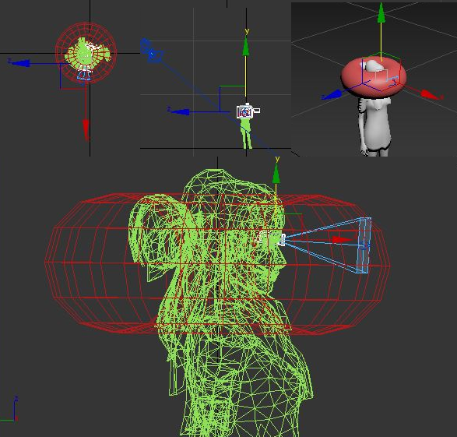
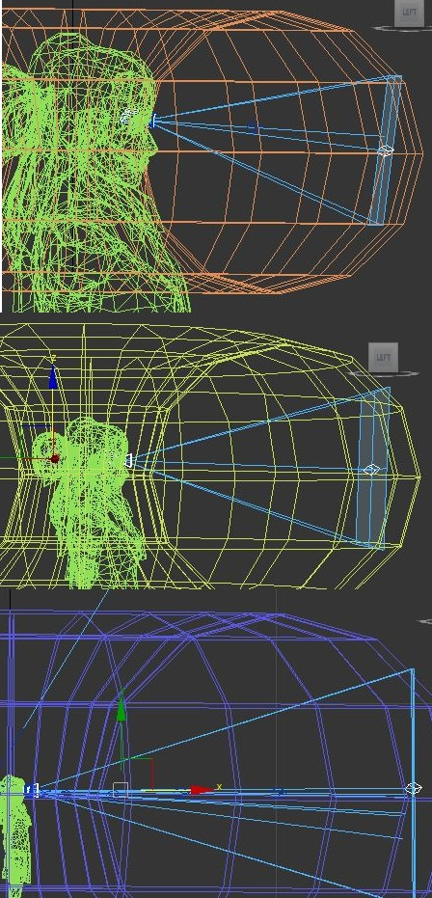
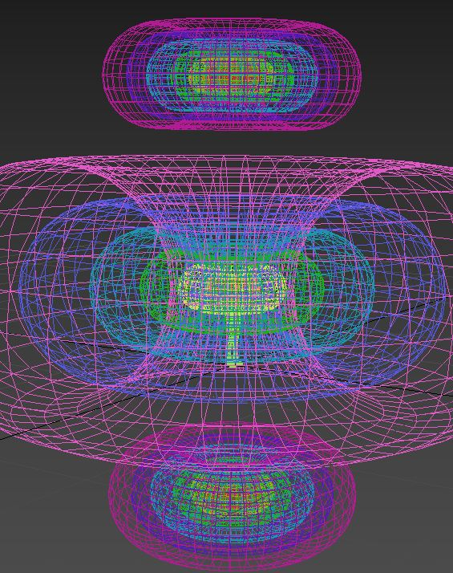
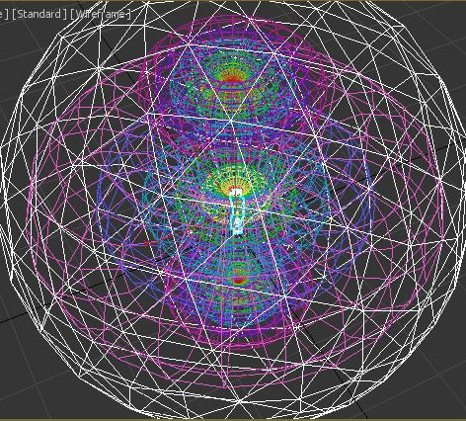

Slide 8


Many screens with easy drag’n’drop of text, images, videos or 3D assets to auto fit on or in Torus Facets
Imagine 1 to 288 screens in surround. Easy to move, merge or separate.

Slide 9
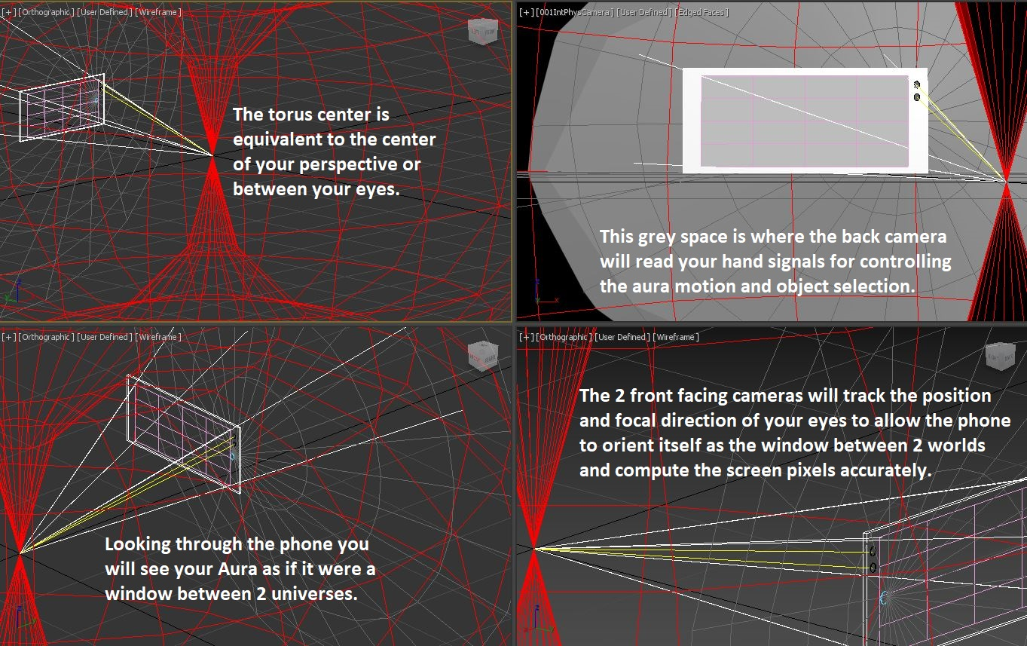

Slide 10
Emotions, Values, Needs and Interests Hierarchies that are easy to drag, drop, organize on Torus facets.
Needs: Personalize human rights, my essentials of life and total control of privacy
Emotions: Select and prioritize motivational preferences for future experiences
Values: Internal personal beliefs; Virtues: External common moral perceptions
Interests: Past, present and future topics, places, spaces, experiences as goals
Frequencies: Health, well being, travel, love, family, learning, spirituality etc.
Accomplishment: Skills and competencies for performing essential activities
Hierarchies: Authority in personal and social life; local, regional and global

Slide 11
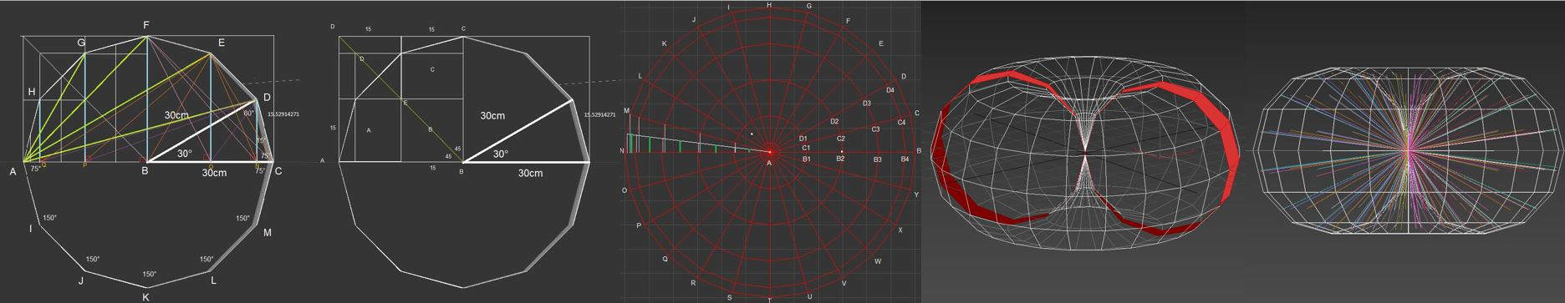
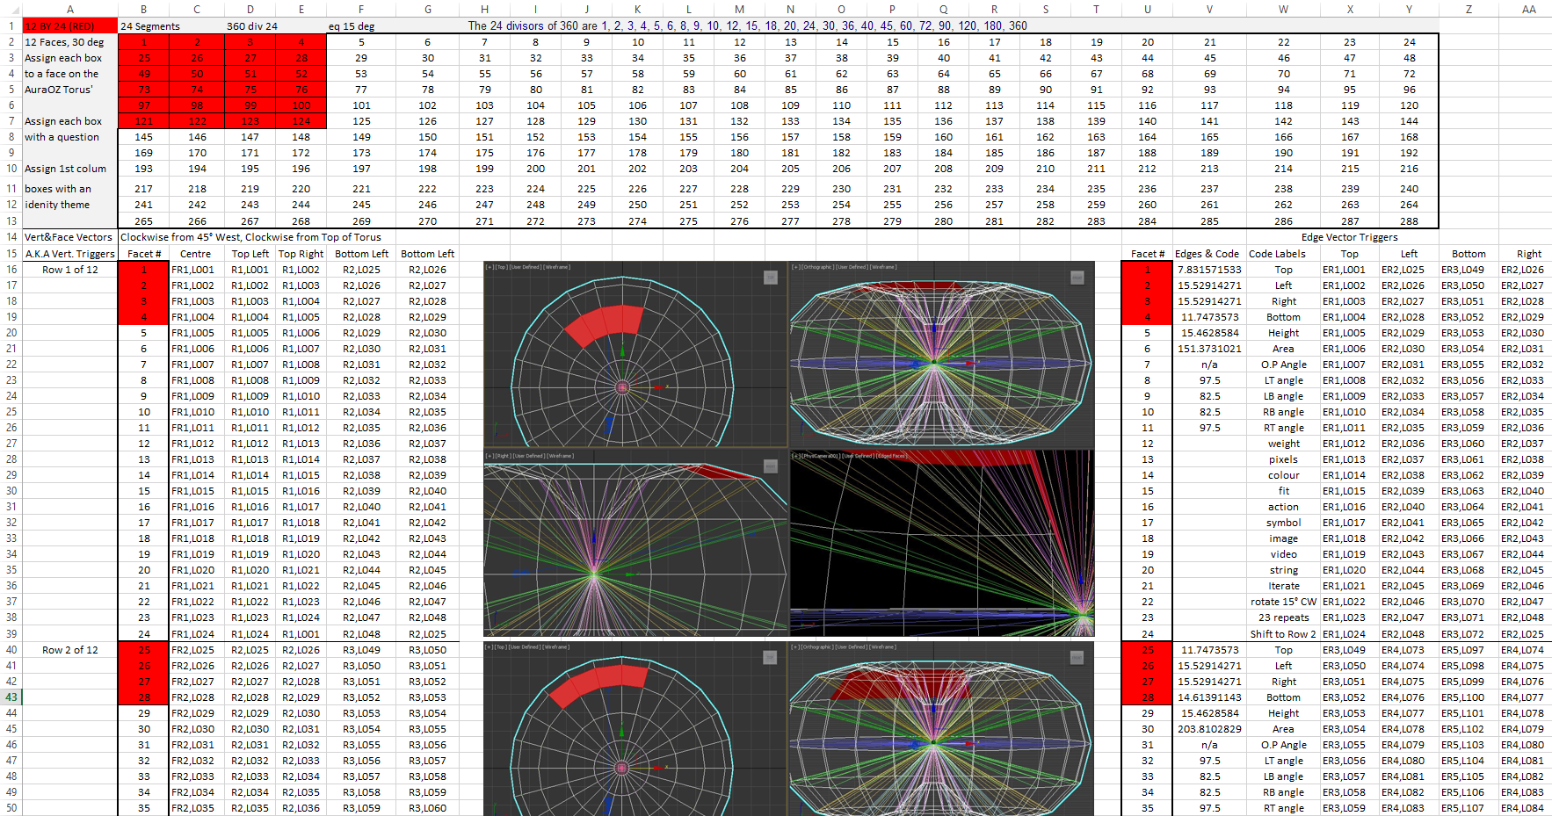
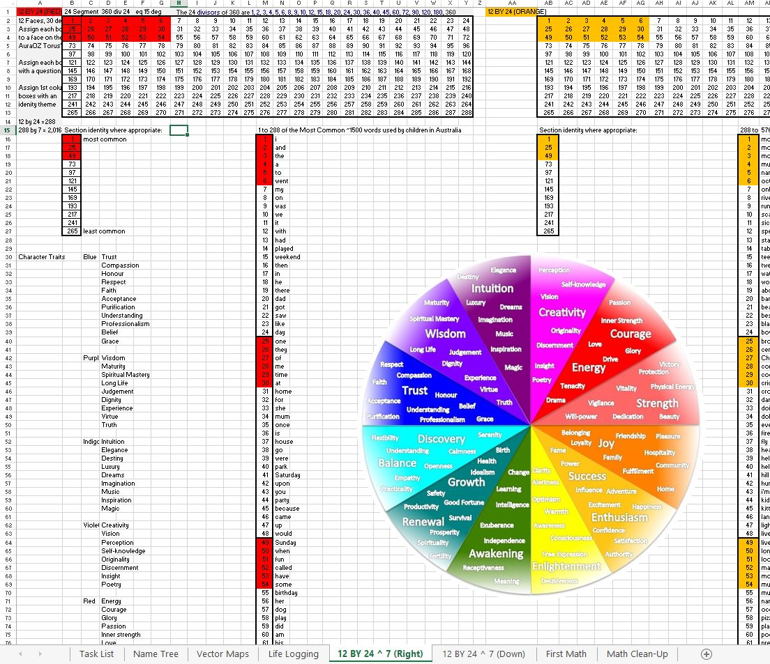

Slide 12
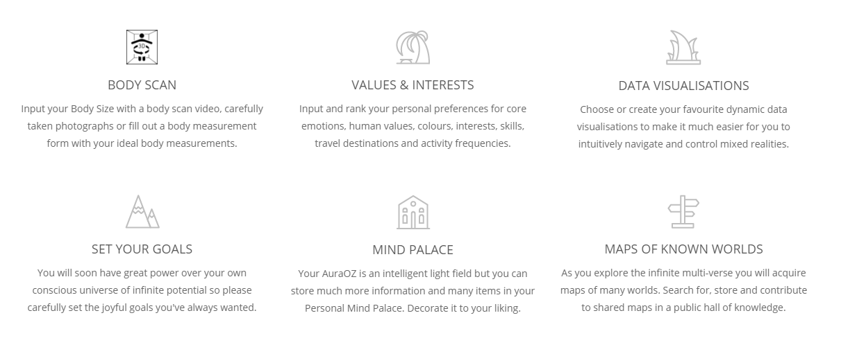
AuraOZ Introduction Process for Classrooms & Demos

Slide 13
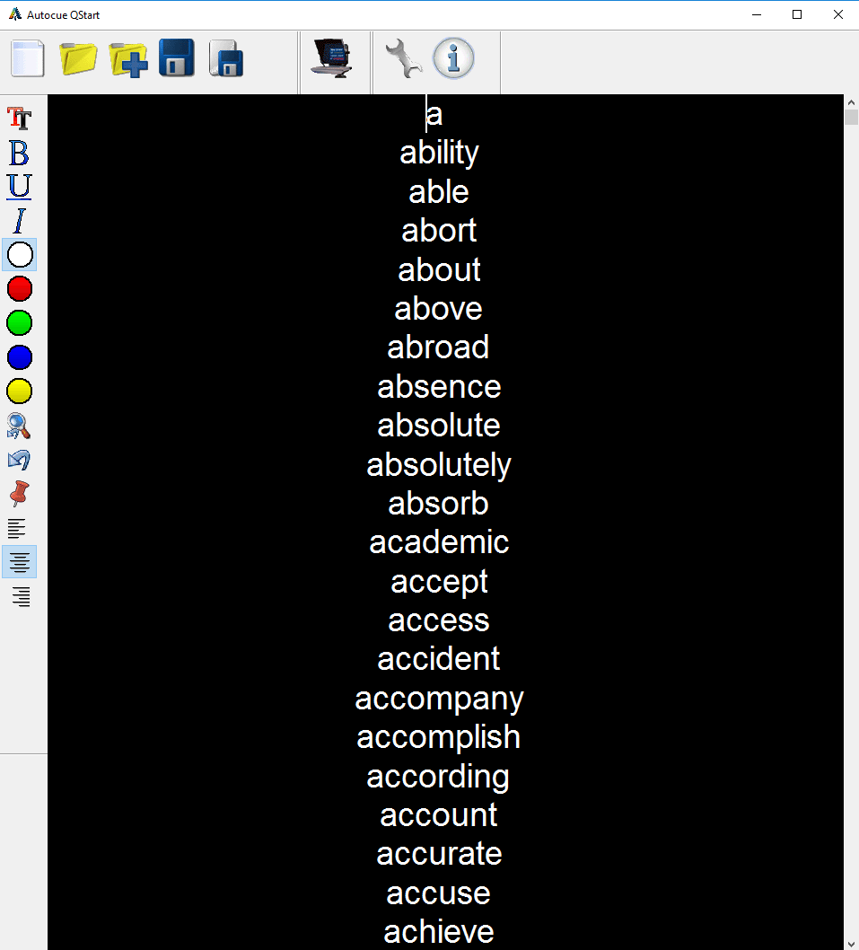

Towards personal artificial intelligence agent Aura: Record the 3000 Most Common English Words
Auto-Cue
Record Video & Audio
Video

Slide 14
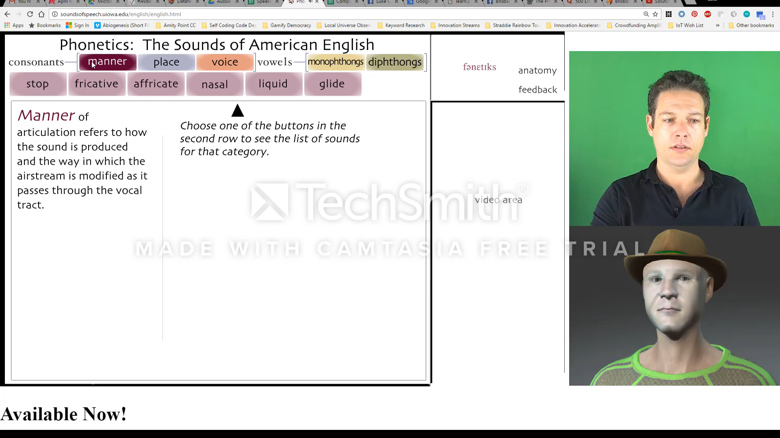
Phonetics: 2D+Text+A/V are Tied to Avatar Motion
Video
Notes:
University of Iowa: Phonetics of American English (Flash Applet) Crazy Talk 8 Animator

Slide 15
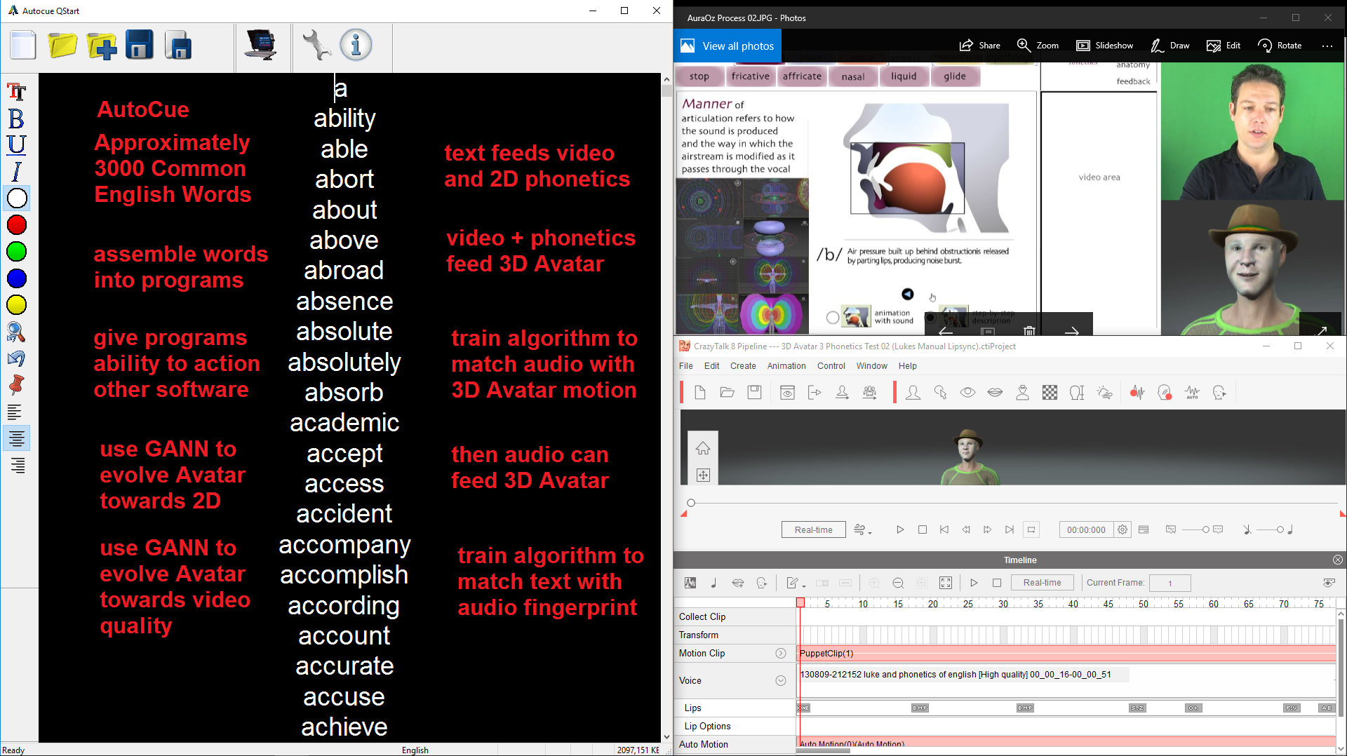
Build Software Demo for this type of self created data

Slide 16
Design Smart Wearables for Individual Preferences
Create an interactive 3D model with “body real estate” for smart accessories
Identify the best sensors available for biometrics, environment and connectivity
Identify opportunities for further sensory research and development goals
Identify the best micro, nano and quantum processors for each accessory type
Identify opportunities for further research and development of processors
Create “easy match” patterns for interchangeable smart fashionable accessories
Engineer a process to customize accessories to match high definition body scan
Create a supply chain for rapid prototyping devices using the best materials

Slide 17
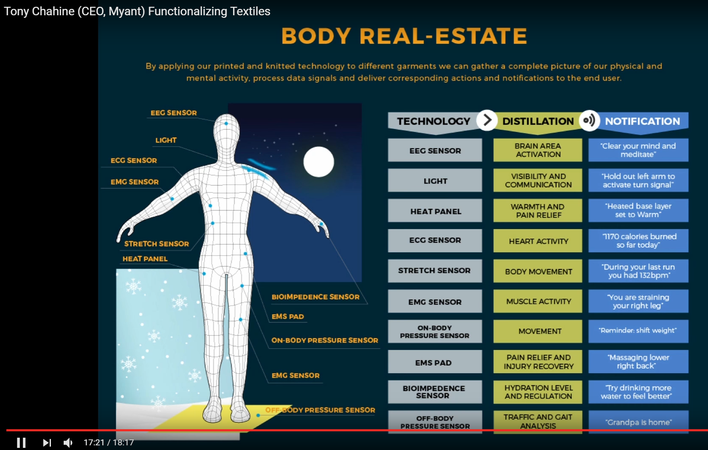


Slide 18
Participatory Governance Thought Experiments
Reimagine Global Governance
GamifyDemocracy.com
Aura Operating Zeitgeist (AuraOZ.com)
Gamify Democracy for Responsible Abundance
Virtual Reality and Mixed Reality Simulations
Quantifiable Verifiable Reputations on Blockchain
True Meaning Language Transliteration Protocol
Personal Extended Intelligence Algorithms
Quantum Superpositioning of Virtual Minds
Simultaneous Overlapping Conversational Governance Protocol
Millionaire AuraOZ and Billionaire AuraOZ for Role Models

Slide 19
Initial Coin Offering:
one Coin to End the monetary system!
Thrive and make the transition. Mankind is entering a golden age!
Know Your Customer Strategy: I.D + Dynamic Privacy Survey + A Wish
Max Supply of Tokens: Yet to be determined
Token Distribution and Listing on Token Exchanges: 1 Calendar month
Length of Pre-Sale Whitelisting: 14 days
Length of Sale: 7 days
Soft Cap: $11 Million AUD
Hard Cap: $50 Million AUD
Token Burn: No
Token Use: AuraOZ Alliance Service Providers, Voting and D.A.App
Pre-Sale Launch Date: Yet to be determined

Slide 20
Initial Coin Offering:
one Coin to End the monetary system!
Thrive and make the transition. Mankind is entering a golden age!
Build your own Aura to thrive in the World of today.
Build your own Aura to create infinite virtual worlds and games.
Build your own Aura to define your ideal lifestyle as if money was no object.
“Joyous, Virtuous and Compassionate Responsible Abundance.”
Funds Allocation: Token Allocation:
50% Responsible Abundance 40% Token Sale
30% In House Development 30% Founding Team
10% Bountiful Incentives 20% NFPO’s (UN SDG’s)
10% Hackathon Prizes 10% Reserve

Slide 21
Initial Coin Offering:
one Coin to End the monetary system!
Thrive and make the transition. Mankind is entering a golden age!
Funds Allocation:
50% Responsible Abundance:
Establishing an Alliance of people, community groups, companies, holiday resorts and service providers around the world that will be first to learn how to build AuraOZ as an independent universal operating system. Then to tutor these creative people on crowd intelligence and start-up hypothesis for global responsible abundance.
30% In House Development
Fill in the remaining gaps of the AuraOZ model driven artificial intelligence in multiple programming languages and responsibly evolve the model with crowd sourced responsible abundance then connect it to Web API’s.
10% Bountiful Incentives 10% Hackathon Prizes
Incentivize big leaps in innovation by offering prizes Run hackathons to develop open source digital assets
to accelerate responsible abundance across the Earth. and interoperability with existing ICT infrastructure.

Slide 22
Initial Coin Offering:
one Coin to End the monetary system!
Thrive and make the transition. Mankind is entering a golden age!
Token Allocation:
40% Token Sale
A 3 Tier Whitelist will be used to incentivize participation from first time users of Cryptocurrency who would not normally have enough resources to invest in improving their future by traditional monetary methodologies. The first 24 hours will be limited to 1 ETH or less. Then 6 hours of 5 ETH limit. Then unlimited to Hard Cap.
30% Founding Team, Top Achieving Staff and Open Source Contributors
Vesting timeline of 12, 24 and 36 months for founding team. Vesting timeline of 3, 6 & 12 months for others.
20% NFPO’s (UN SDG’s) 10% Reserve
Gifted to select NFPO’s to solve the SDG’s & use AuraOZ. First Test of Participatory Governance.
Vesting timeline relative to launching in new countries as No allocation or specific use timelines.
legal systems and internet services allow for expansion. Strategic Reserve for unforeseen times.
*Not for Profit Organizations. **Sustainable Development Goals

Slide 23

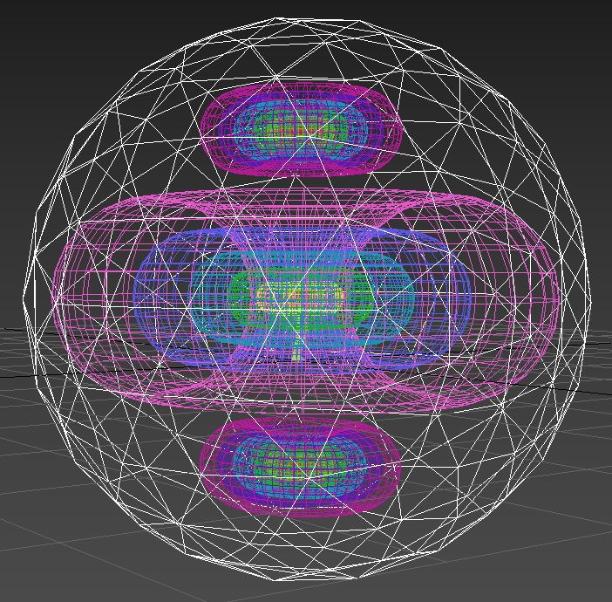
Contact Info
Thank You
http://auraoz.com
For Participating. AuraOZ

